Slide 1




Airbnb Listing Analysis
Shujie Deng (301171263)

Slide 2



Analysis Outline
1. Executive Summary
2. Data Introduction
3. Data exploration
4. Modeling Recommendation
Conclusion and Recommendations

Slide 3





Executive Summary-Introduction
A web platform where users can rent out their space to travelers.
Save Money when traveling. Make Money when hosting.
Share culture by making a local connection to the city.

Slide 4





Executive Summary-Introduction
Becoming more competitive
Increasing the number of reservation
Attracting more hosts to invest in Airbnb

Slide 5





Business Problem ﻿
How can a host to determine the appropriate price?
How can the new host know where and what types of property to invest in?
How does travelers know what aspects to look into to find a suitable listing?

Slide 6



Data Introduction
Data retrieved from Inside Airbnb
Data collected from June 05, 2021 to June 05, 2022
Data including 71 attributes (this analysis mainly focuses on 15 features)

Slide 7

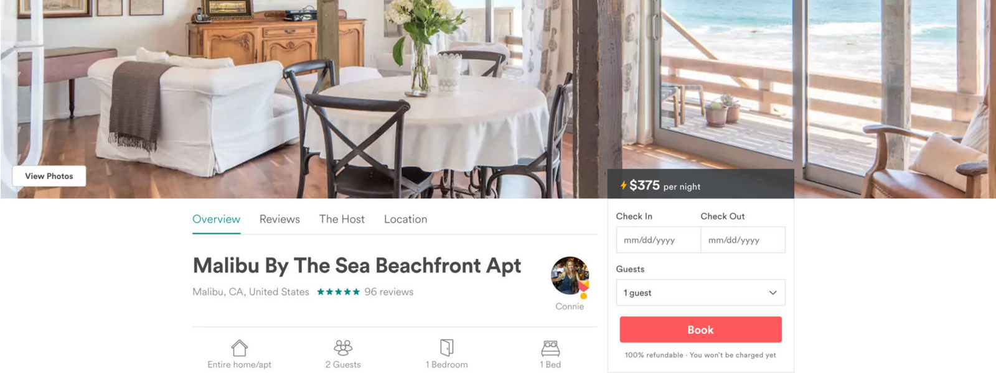
Data Exploration

Slide 8
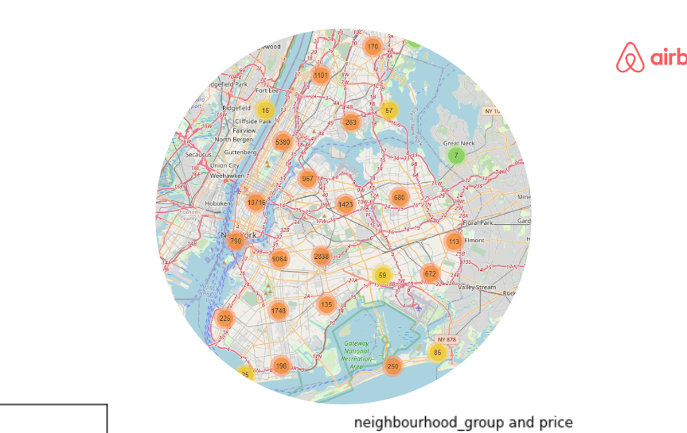


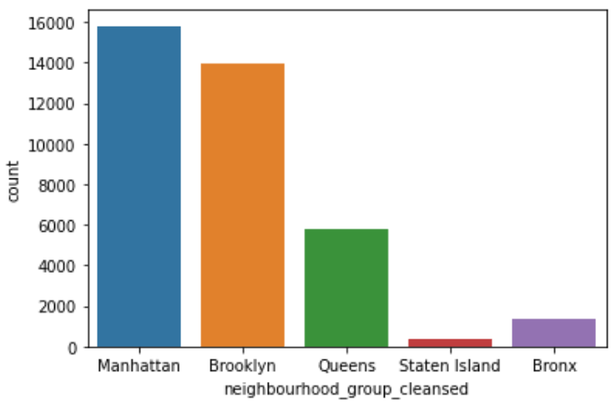
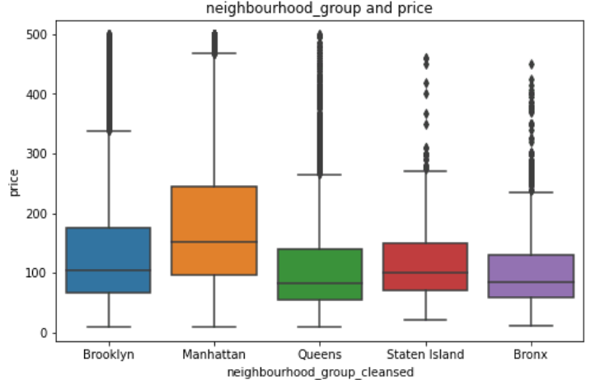
Listing Map
37410 listings in New York
Most listing in Manhattan and Brooklyn area

Slide 9

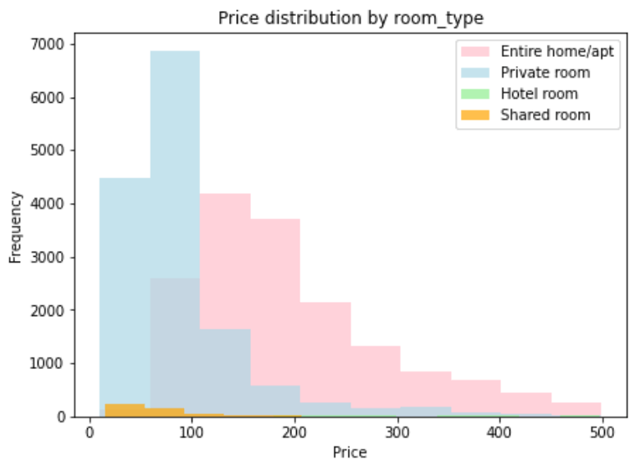
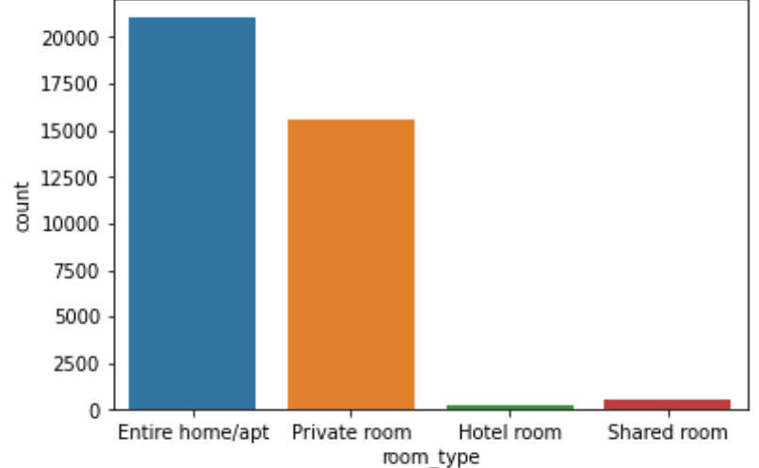
Room Type Analysis

Slide 10

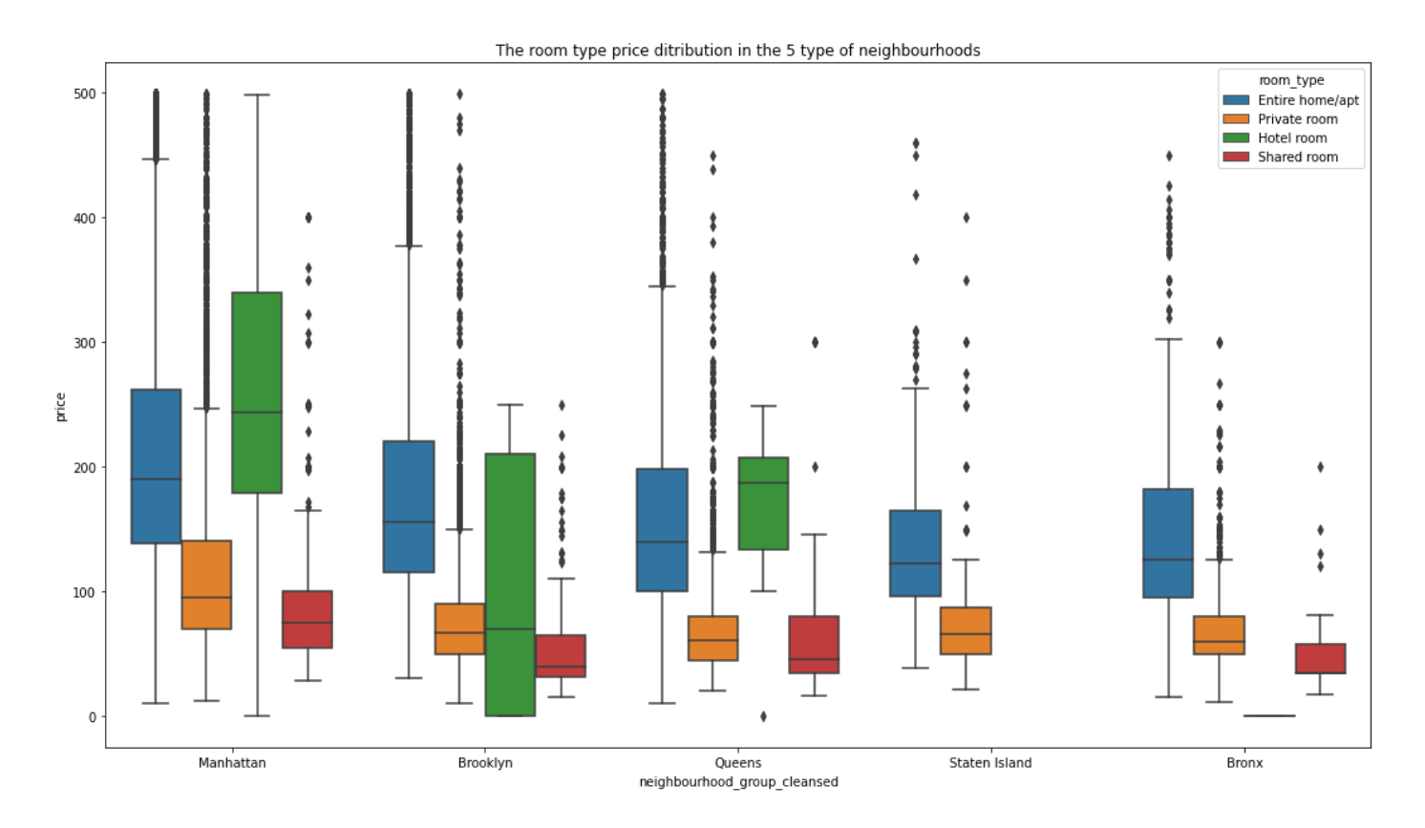
Room Type & Neighborhood Analysis

Slide 11

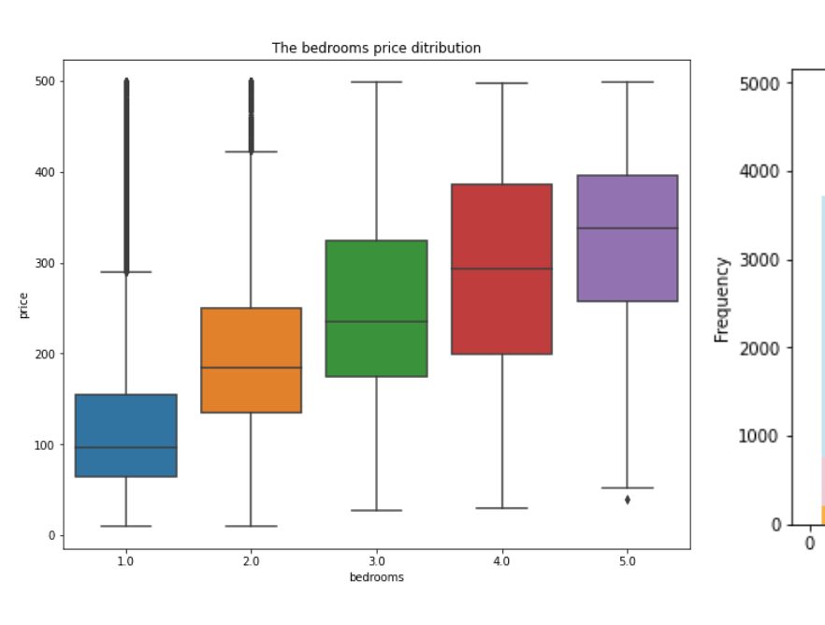
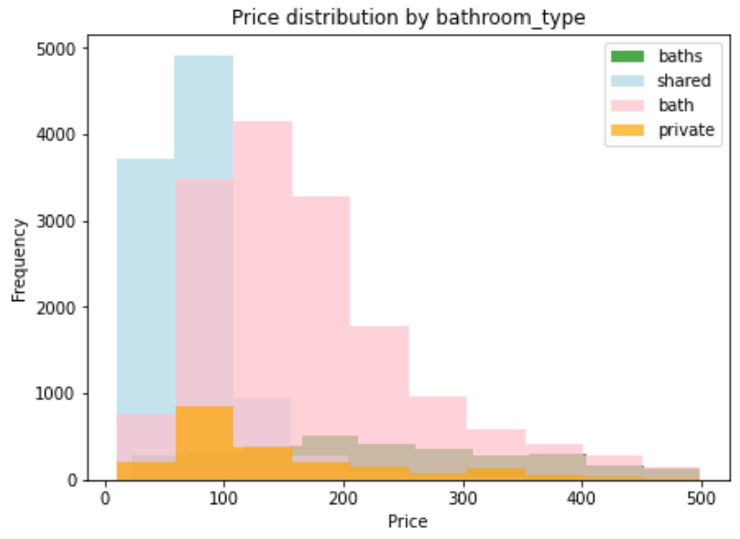
Bedroom & Bathroom Analysis

Slide 12

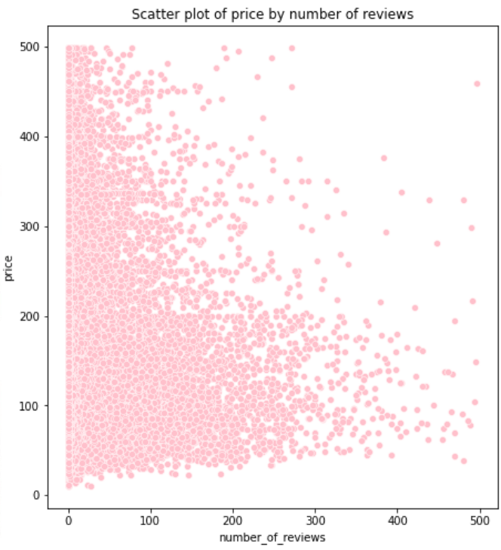
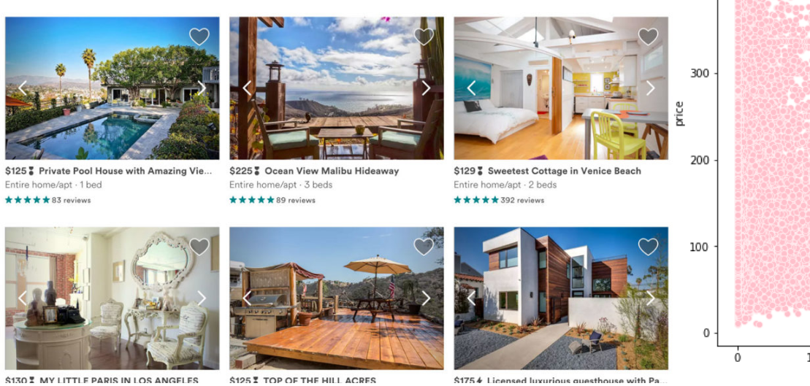
Number of Review Analysis

Slide 13

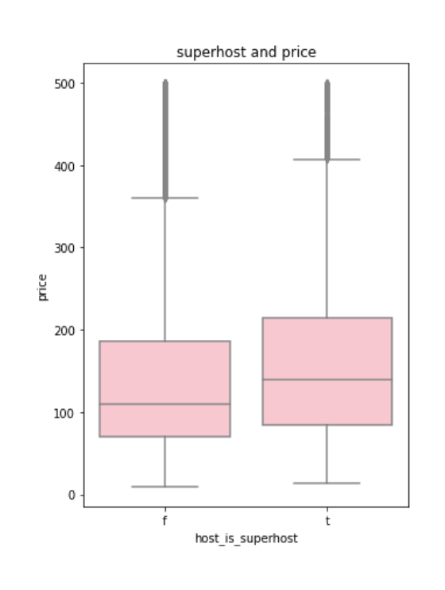
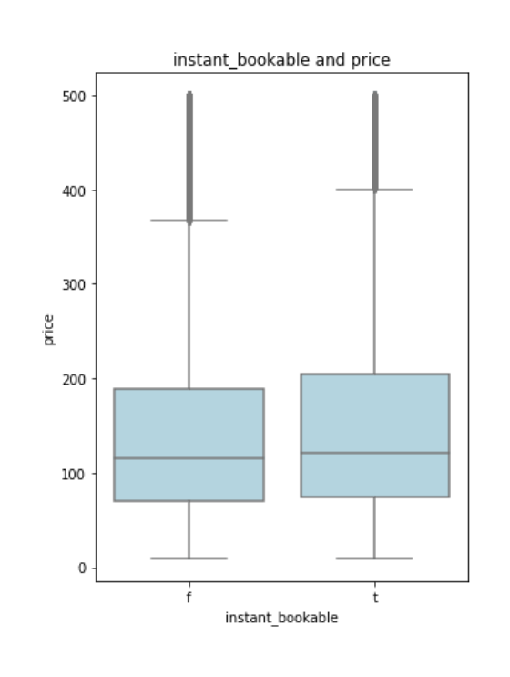
The Superhost and Instant Bookable Analysis

Slide 14


Modeling Recommendation

Slide 15



Model Comparison
RMSE
R squared
Decision Tree
0.51
0.161
Random Forest
0.49
0.163
Gradient Boost
0.48
0.194
XGBoosting
0.45
0.19
* 60% training data, 40% valid data
* RMSE: Root Mean Square Error is a standard way to measure the error of a model in predicting quantitative data. Generally, the lower the RMSE, the better a given model is able to fit the dataset.
* R squared: In general, the higher the R-squared, the better the model fit the data.

Slide 16

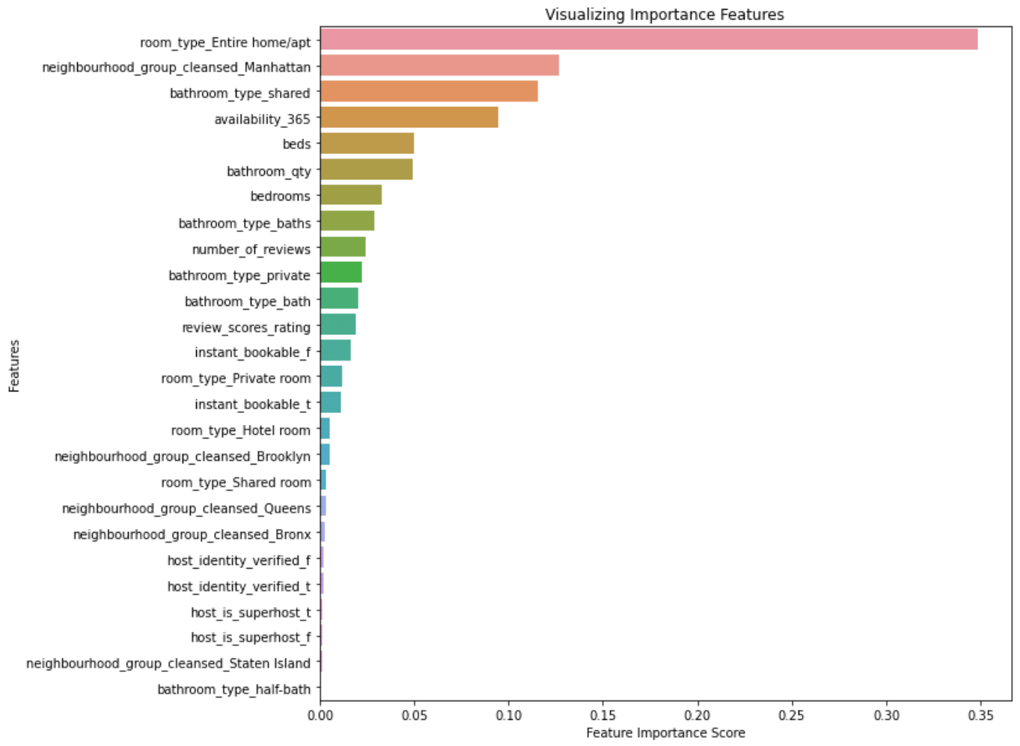

Model Features ﻿

Slide 17




Conclusion and Recommendations
More accurate data
Filtering features for new host
Actual pricing software
eg: including the average prices paid per night
eg: availability and reviews
eg: besides projecting base pricing, a sequence model might calculate daily rates based on seasonality and occupancy

Slide 18



Thank you!
Q & A

